Slide 1
POINTERS CONTD.

Slide 2
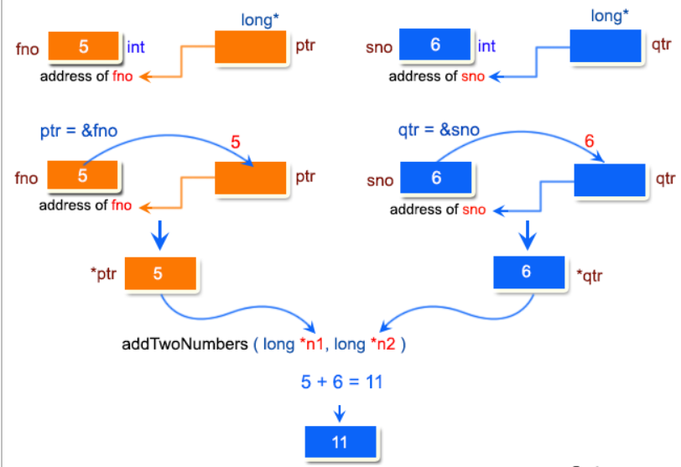
Q1 DIAG

Slide 3
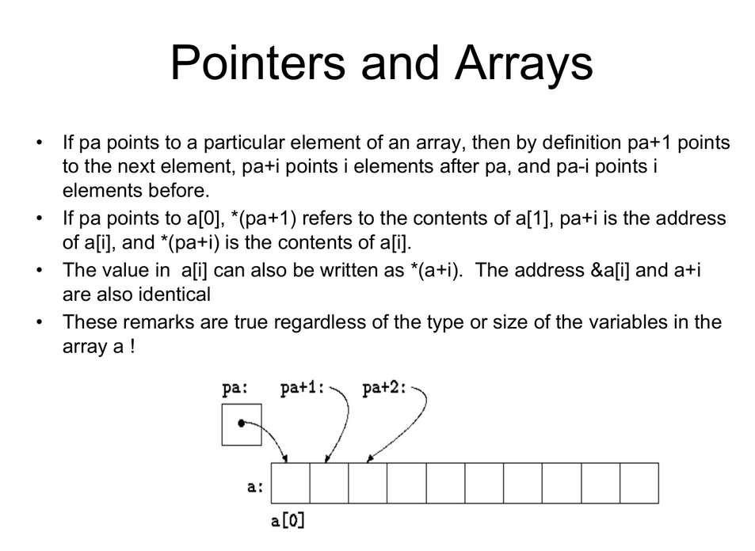

Slide 4
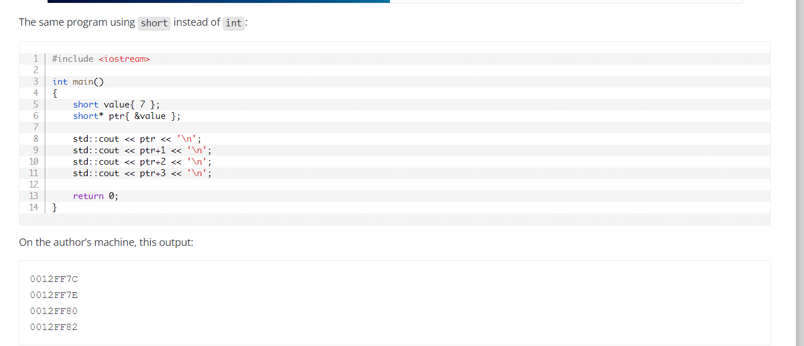
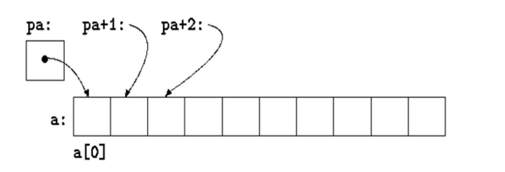
Pointer Arithmetic

Slide 5
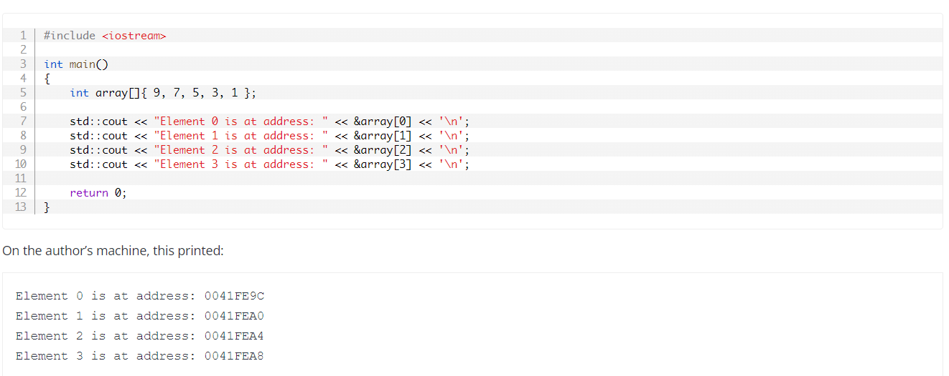

Slide 6
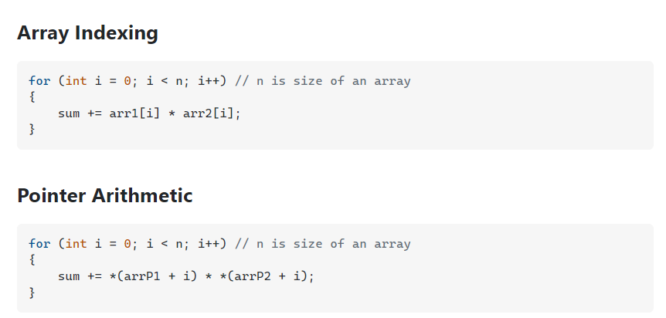

Slide 7
https://www.w3resource.com/c-programming-exercises/pointer/index.php
https://www.eskimo.com/~scs/cclass/notes/sx10b.html
https://www.algbly.com/More/MCQs/Cpp-mcq/Cpp-pointers.html
https://www.daniweb.com/programming/software-development/threads/403497/trying-to-grasp-pointers-in-their-entirety

